Slide 1
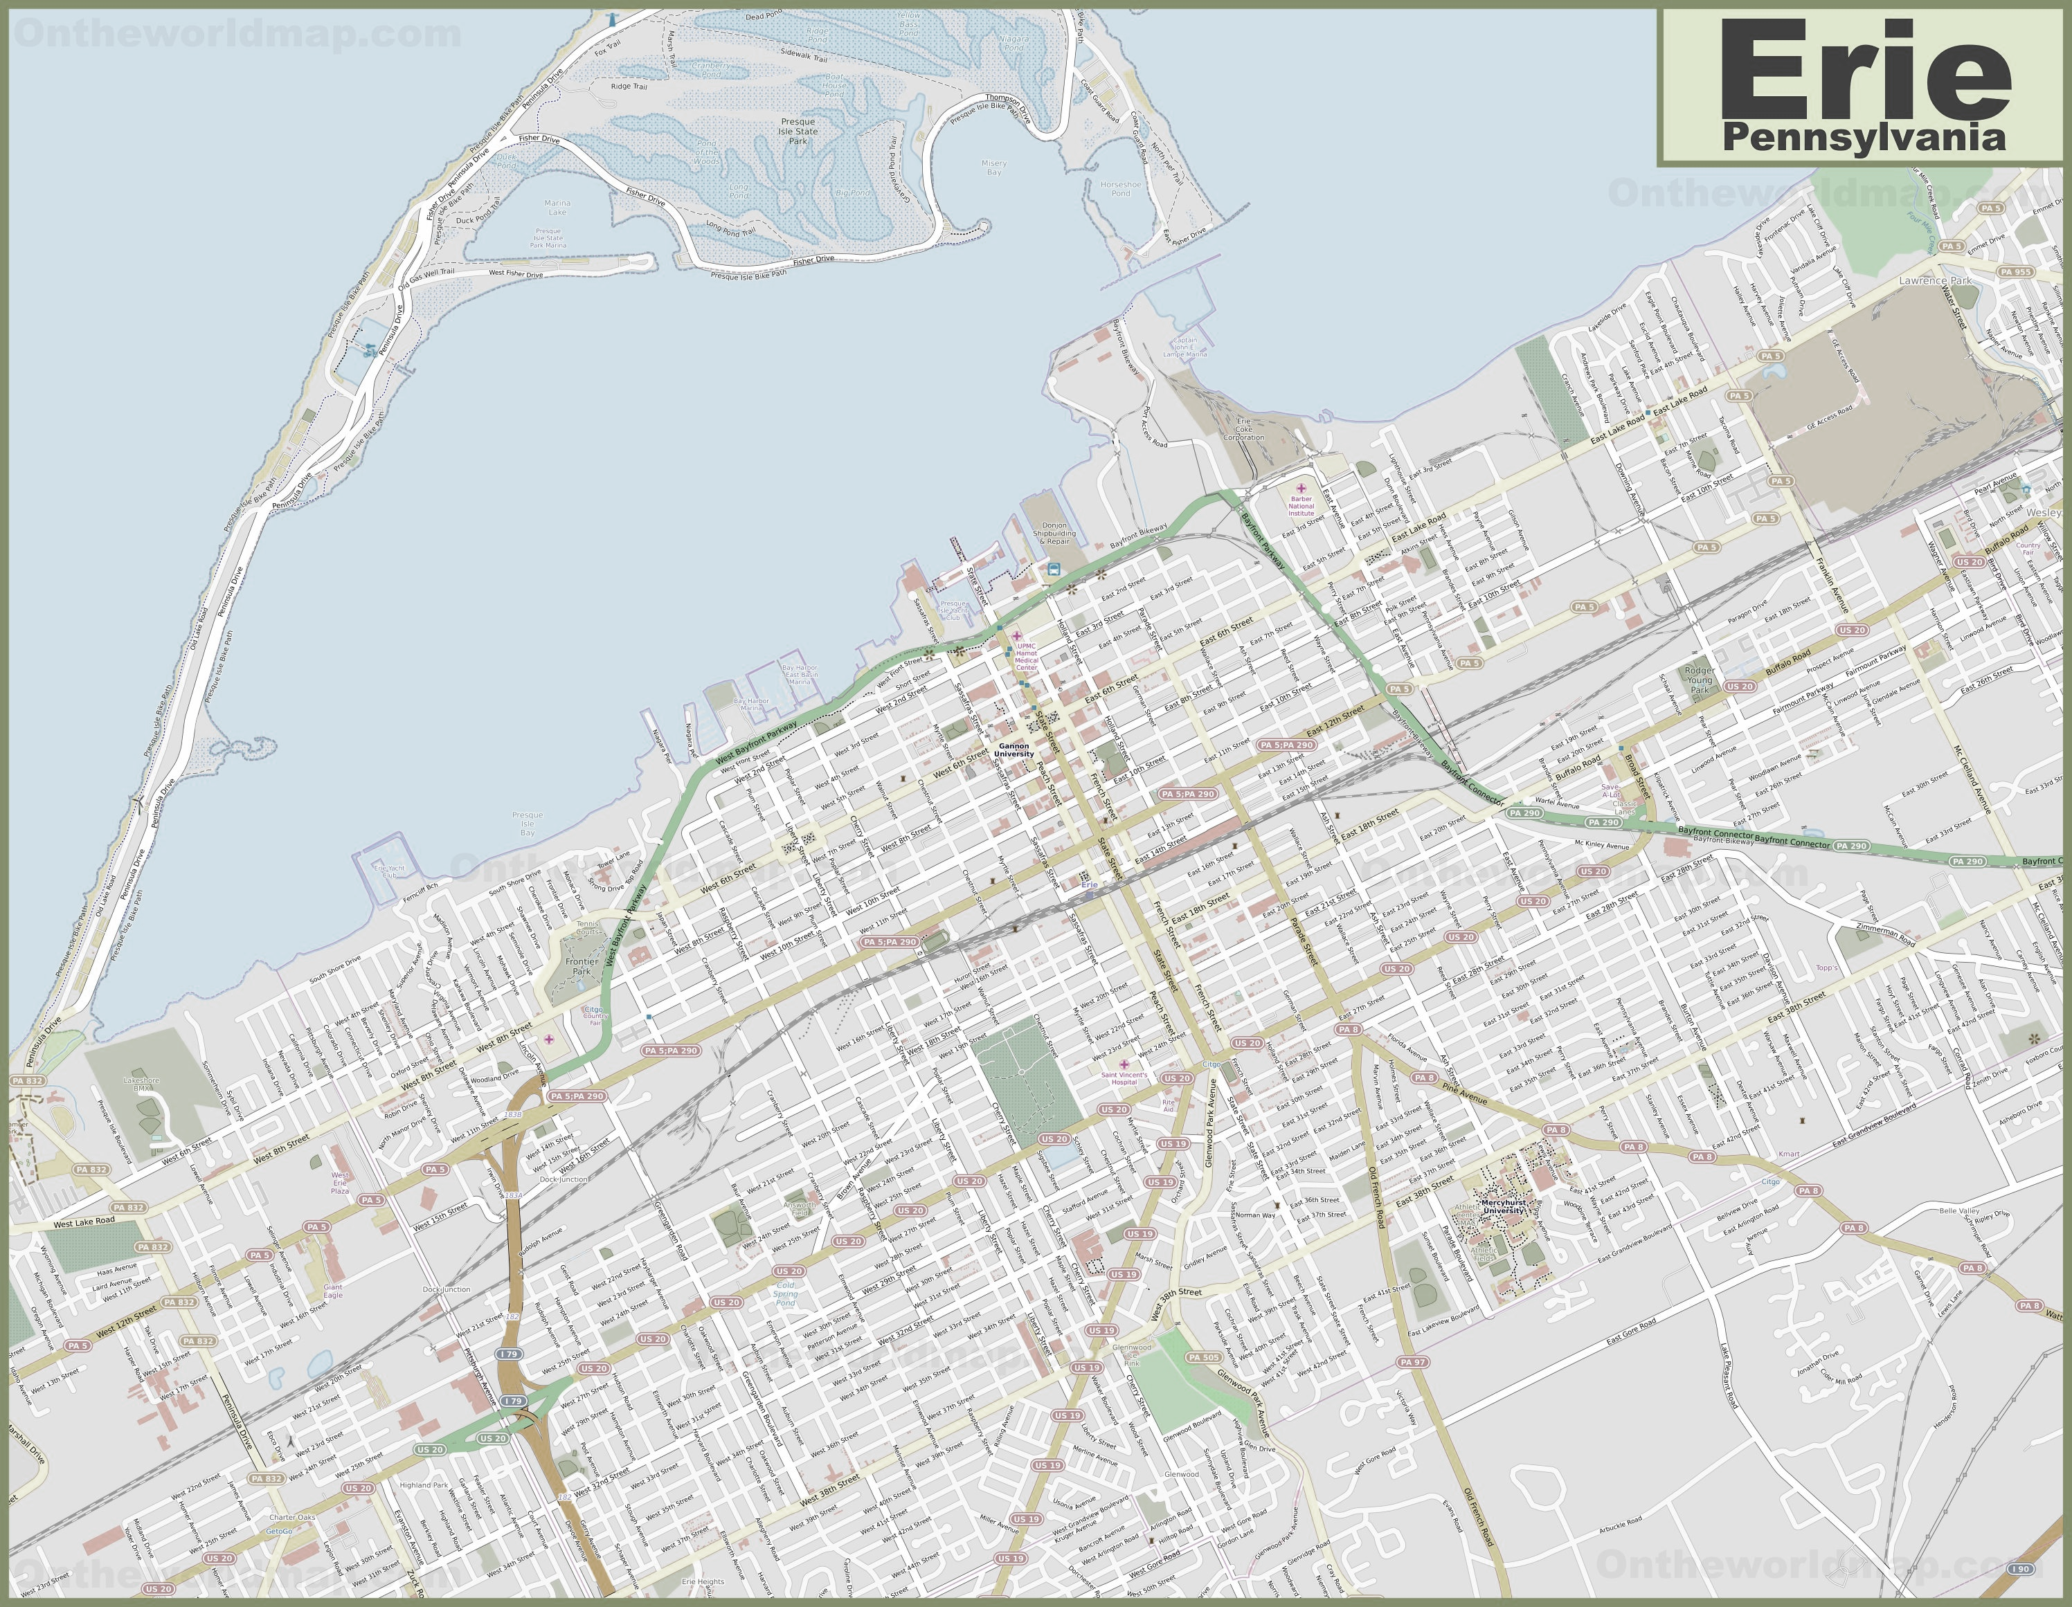
American Rescue Plan Council of Advisors
October 22, 2021

Slide 2
“It is therefore the policy of my Administration that the Federal Government should pursue a comprehensive approach to advancing equity for all, including people of color and others who have been historically underserved, marginalized, and adversely affected by persistent poverty and inequality.”
“By advancing equity across the Federal Government, we can create opportunities for the improvement of communities that have been historically underserved, which benefits everyone.”
JOSEPH R. BIDEN JR.
THE WHITE HOUSE, January 20, 2021

Slide 3
Agenda
Overview of ARP
Defining the Projects
Role of ARP Council of Advisors
Approved Projects and Council Schedule
Social Engagement Tool
Next Steps

Slide 4
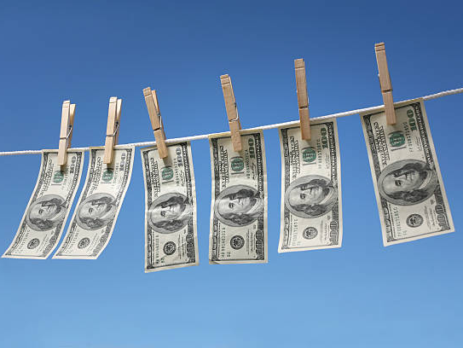
What’s in a Name?
American Rescue Plan Act
Coronavirus State & Local Fiscal Recovery Funds
CSLFRF
ARP
CLFRF
ARPA

Slide 5
American Rescue Plan (ARP) of 2021 $1.9 Trillion
$350B: Coronavirus State & Local Fiscal Recovery Fund
$10B: Coronavirus Capital Projects
$656.18B: Direct Financial Assistance (Stimulus Checks, Unemployment, Tax Credits, EIDL, PPP, etc.)
$211.57B: Education & Childcare
(CCDBG, Education Stabilization, Child Care Entitlements, LIHEAP, LIHWAP, Head Start)
$86.24B: Health (Emergency Rural Development Grants, Behavioral Health Clinic Expansion, Various Mental Health and Substance Abuse Programs, Testing & Vaccine Grants, etc.)
$40.16B: Transportation (Transit
Infrastructure Grants, Relief for Airports, Amtrak)
8 $61.32B: Other Programs (Disaster Relief Fund, Emergency Food and Shelter Programs, Assistance to Firefighter and Emergency Response Grants, Emergency Management Performance Grants, Economic Development Assistance Programs, Environmental Justice Grants, etc.)
1
5
2
6
3
7
$56.27B Assistance to Individuals & Families (SNAP, EBT, WIC, Nutrition Assistance, IDEA, Veterans Affairs, Family Violence Prevention, Pandemic Emergency Assistance, OAA, Elder Justice Act, Rental Assistance, Homelessness Assistance, Homeowner Assistance, Rural Housing, etc.)
4

Slide 6
Coronavirus State and Local Recovery Funds (CSLRF/ARP) to Pennsylvania
ARP/CSLRF allocated $6.15 billion to Pennsylvania counties, metropolitan cities, and local government units to support COVID-19 response efforts, replace lost revenue, support economic stabilization for households and businesses, and address systemic public health and economic challenges.
ARP funds will be issued in two tranches to local governments.
Erie County received its own ARP allocation of $52 million.
Erie Public Schools received an allocation of $94 million.

Slide 7
ARP Timing
WINTER 2020: PANDEMIC BEGINS
MARCH 3, 2021:
ARP EFFECTIVE DATE
SUMMER 2021:
FIRST ½ DISTRIBUTION
SUMMER 2022:
SECOND ½ DISTRIBUTION
Reporting
Interim Report: August 31, 2021
Project & Expenditure Report: January 31, 2022 and then 30 days after the end of each quarter thereafter.
DECEMBER 31, 2024: ALL FUNDS OBLIGATED
DECEMBER 31, 2026:
ALL FUNDS FULLY EXPENDED

Slide 8
Pennsylvania COVID-19 ARPA Local Fiscal Recovery Fund Allocations to Metropolitan Cities
Abington $19,107,973.00
Allentown $57,132,604.00
Altoona $39,258,106.00
Bensalem Twp. $9,497,764.00
Berwick Borough $7,287,582.00
Bethlehem $34,467,364.00
Bloomsburg $6,275,309.00
Bristol Township $15,886,687.00
Carlisle $9,186,671.00
Chambersburg $7,763,037.00
Chester $30,357,628.00
East Stroudsburg Boro $2,813,500.00
Easton city $20,665,806.00
Erie $76,098,836.00
Gettysburg Borough $3,136,677.00
Hanover borough $7,573,079.00
Harrisburg $47,073,625.00
Haverford $19,840,290.00
Hazleton $17,132,482.00
Johnstown $30,716,690.00
Lancaster City $39,518,923.00
Lebanon $16,672,455.00
Lower Merion $25,503,294.00
Mckeesport $24,753,914.00
Millcreek Township $5,860,073.00
Norristown $20,140,217.00
Penn Hills $17,129,203.00
Philadelphia $1,087,606,822.00
Pittsburgh $335,070,222.00
Reading $61,134,970.00
Scranton $68,746,050.00
Sharon $14,382,307.00
State College $13,276,247.00
Upper Darby $41,761,939.00
Waynesboro Boro $4,251,774.00
Wilkes-Barre $37,156,228.00
Williamsport $25,477,801.00
York $35,304,707.00

Slide 9
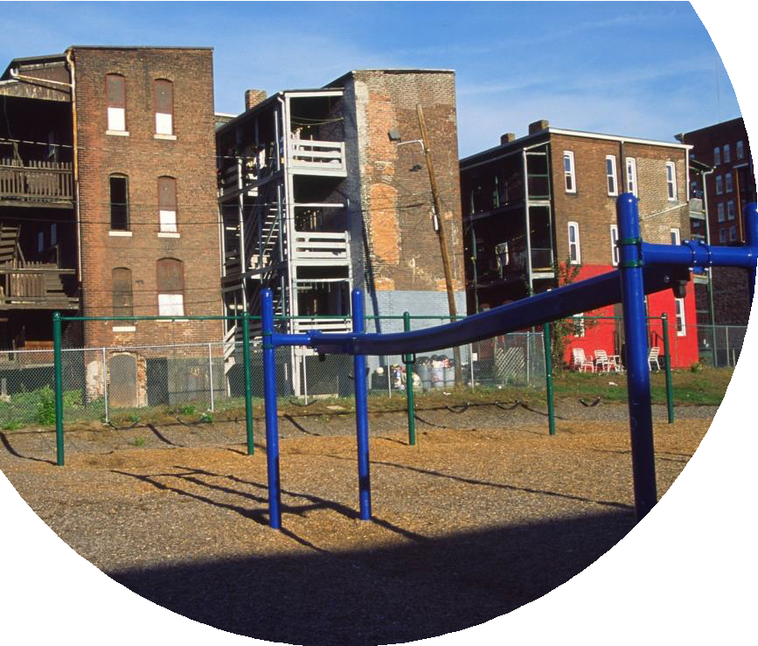
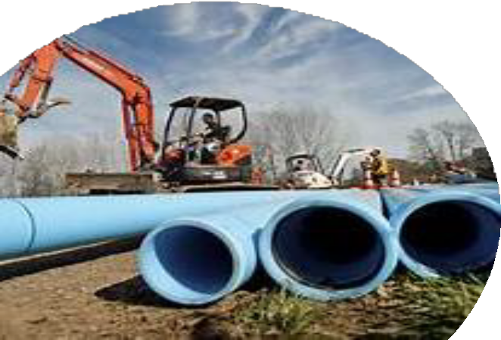
Goals of ARP
Support urgent COVID-19 response efforts to continue to decrease spread of the virus and bring the pandemic under control.
Replace lost public sector revenue to strengthen support for vital public services and help retain jobs.
Support immediate economic stabilization for households and businesses.
Address systemic public health and economic challenges that have contributed to the unequal impact of the pandemic.

Slide 10
Allowable Expenditures
Address COVID
Public Health
Support public health expenditures, by funding COVID-19 mitigation efforts, medical expenses, behavioral healthcare, and certain public health and safety staff;
Services to Disproportionately Impacted Communities
Address health disparities and the social determinants of health, build stronger neighborhoods and communities, address educational disparities, and promote healthy childhood environments.
Address COVID
Economic Impact
Address negative economic impacts caused by the public health emergency, including economic harms to workers, households, small businesses, impacted industries, and the public sector;
Replace Lost
Revenue
Replace lost public sector revenue, using this funding to provide government services to the extent of the reduction in revenue experienced due to the pandemic;
Premium Pay
Infrastructure
Investments
Invest in water, sewer, and broadband infrastructure, making necessary investments to improve access to clean drinking water, support vital wastewater and stormwater infrastructure, and to expand access to broadband internet.

Slide 11
Can We Repave a City-Owned Walking Trail?
Services to Disproportionately Impacted Communities
Address COVID Economic Impact
Replace Lost Revenue
Infrastructure Investments
Address health disparities and the social determinants of health, build stronger neighborhoods and communities, address educational disparities, and promote healthy childhood environments.
Address negative economic impacts caused by the public health emergency, including economic harms to workers, households, small businesses, impacted industries, and the public sector;
Replace lost public sector revenue, using this funding to provide government services to the extent of the reduction in revenue experienced due to the pandemic;
Invest in water, sewer, and broadband infrastructure, making necessary investments to improve access to clean drinking water, support vital wastewater and stormwater infrastructure, and to expand access to broadband internet.
Is the trail or park in a Qualified Census Tract?
Does the local government have any
calculated “lost revenue” according to US
Treasury formula?
Would repairing or improving the site primarily benefit low- income citizens or others disproportionately -impacted by the pandemic?
Are there other ARP/CLFRF eligible expenses that the local government could supplant to free up general fund monies for this project?
Is the project necessitated by significant increased use during pandemic?

Slide 12
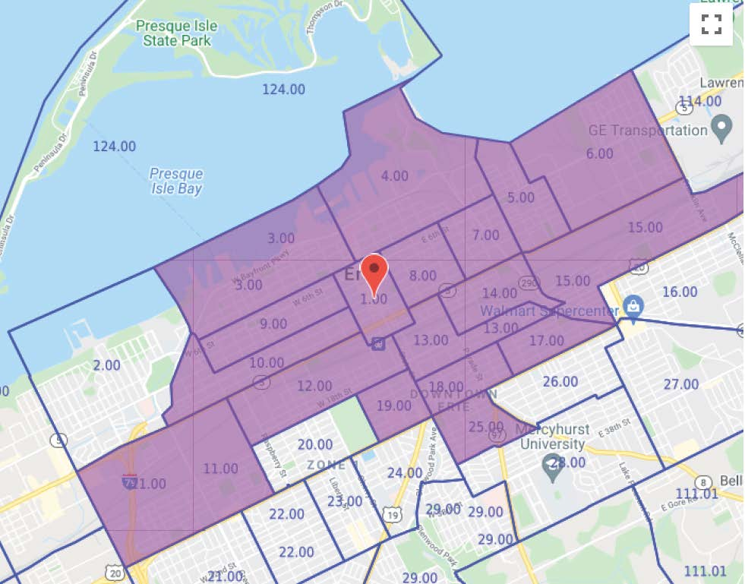
Qualified Census Tract (QCT)
Qualified Census Tracts (2021) - 50 percent of households with incomes below 60 percent of the Area Median Gross Income.
QUALIFIED CENSUST TRACT INFORMATION
Total Erie QCTs in 2021 | 19
Population | 50,300
Racial Breakdown | 53% White | 47% Non-white
Qualified Census Tract Breakdown | In QCT | In City
Blighted properties | (84%) 124 | 146
ERA or ELB owned lots | (98%) 125 | 129
Rental | (65%) 5,773 | 8,818
Parks | (62%) 29 | 47
Neighborhood Organizations | (100%) 10 | 10

Slide 13
In a QCT or Benefiting Low- or Moderate-Income Residents?
Programs to address health disparities
Rent, mortgage assistance, utility bill subsidies
Home repairs, weatherization, remediation of lead paint
Job training to address negative economic or public health impacts experienced due to a worker’s occupation or level of training
Affordable housing
Programs to support educational disparities
Community intervention programs
Behavioral and mental health programs
Investments in parks, greenways, and other public facilities
Programs promoting healthy childhood environments

Slide 14
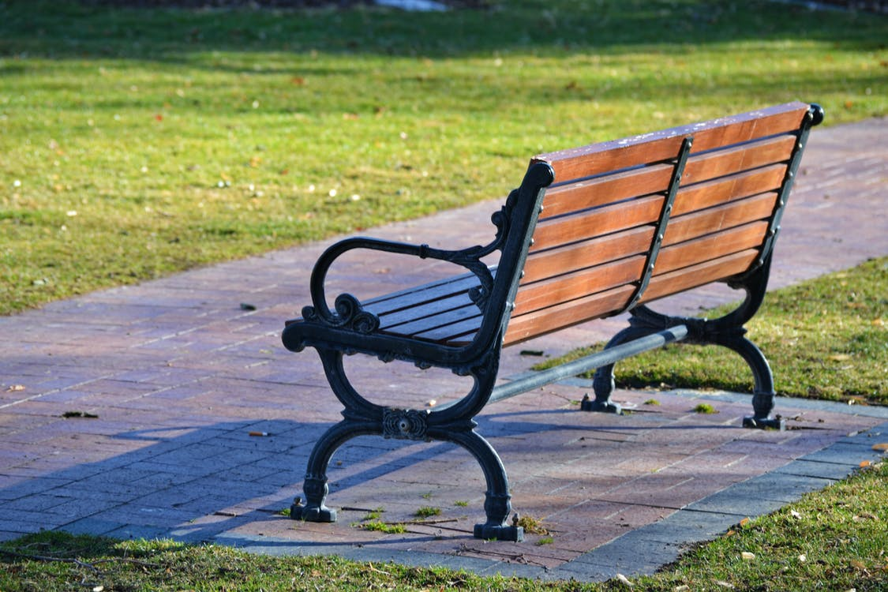
Public Parks & Plazas
In QCT to “build stronger communities” and services to address “social determinants of health”, i.e. “parks, public plazas, and other public outdoor recreation” (IFR fn 49, FAQ 2.18)
Assistance to small businesses, could include outdoor spaces for COVID-19 mitigation or to improve built environment of neighborhood (FAQ 2.18)
Other: Damage or increased maintenance needs (FAQ 2.18)

Slide 15
Address Covid-19 Negative Economic Impact
1.What is the specific negative economic impact due to the pandemic? 2.Does project address the negative economic impact?
IS IT IN A QUALIFIED CENSUS TRACT (QCT) OR BENEFITING INDIVIDUALS IN A QCT?
DOES IT ADDRESS A DISPROPORTIONATELY NEGATIVELY IMPACTED GROUP, AREA,
OR HOUSEHOLD?
DOES IT ADDRESS A NEGATIVE ECONOMIC IMPACT ON THE LG? (NOT LOST REVENUES)
DOES IT ADDRESS A NEGATIVE ECONOMIC IMPACT IN THE COMMUNITY?

Slide 16
Ineligible Expenses
Borrowing money, loan repayments
Rainy day fund contributions or financial reserves
Litigation costs
As a non-Federal match for most other federal funds, included State Revolving Fund grants
General growth or economic development purposes
Pension contributions
Tax cuts

Slide 17
Suggestion:
Work Backwards

Slide 18
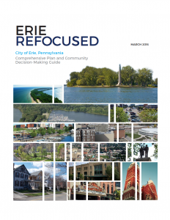
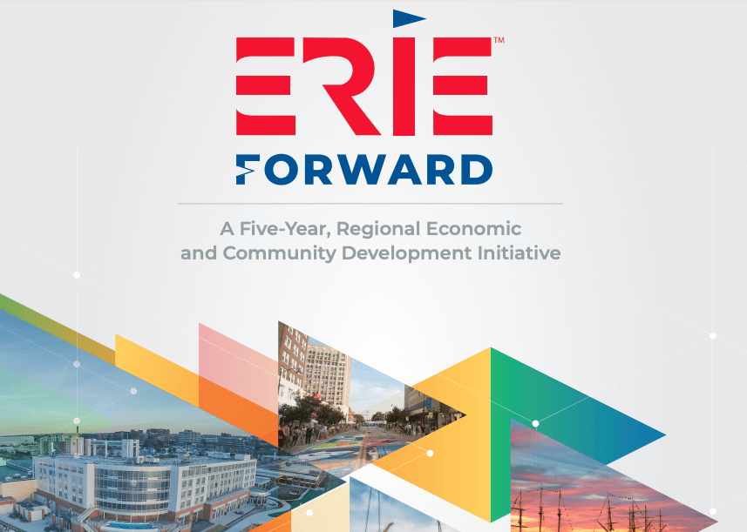
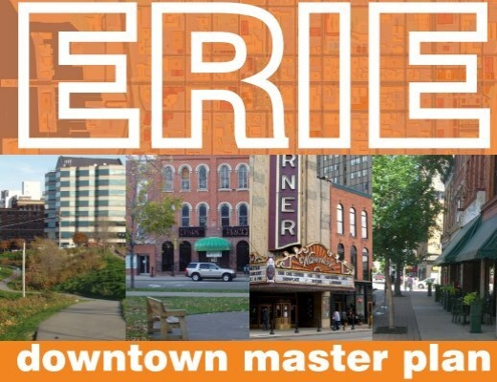
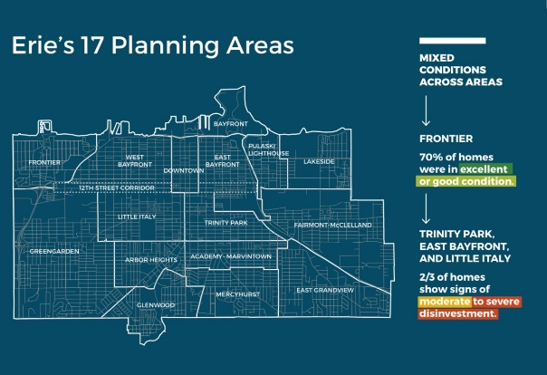
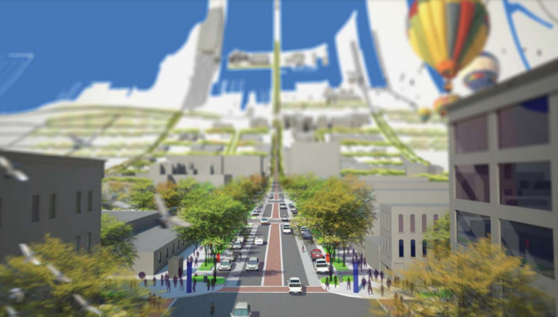
Understanding the Needs of Our Community

Slide 19
Who has Informed our Priorities?
Mayor’s LGBTQ+ Advisory Council
Strengthening Police Community Partnerships (SPCP) Council
Better Together Council
New American Council
Mayor’s Business Council
Labor Round Table
Disability Round Table
City Planning Commission
Erie Neighborhood Growth Partnership
Historically-Black Affiliations (HBA) Council
Minority Community Investment Coalition
African American Concerned Clergy
United Clergy of Erie
Thousands of residents through surveys and door-to-door initiatives

Slide 20
“… a comprehensive approach to advancing equity for all, including people of color and others who have been historically underserved, marginalized, and adversely affected by persistent poverty and inequality.”
Diversity
Equity
Inclusion

Slide 21
THE CITY
OF ERIE
OUR MISSION
Build Opportunity.
Restore Hope.
Transform Erie.
OUR VISION
Erie is a Community of Choice. We celebrate our:
Rich Cultural Diversity
Welcoming, Vibrant Neighborhoods
World-class Downtown and Bayfront
Excellent Education for Everyone
Abundance of Family-sustaining Jobs

Slide 22
Are we making good decisions?
Is it impacting our community?
Are we meeting our goals to advance equity?
Setting
Setting Goals
Measuring
Measuring Success
Analyzing
Analyzing Outcomes

Slide 23
Role of the ARP Council of Advisors
Revisit Goals
Activate our Vision and create the DEI decision lens
Refine Course
Make mid-course corrections, if necessary
Promote Programs and Initiatives
Get the word out to your networks
Analyze Outcomes
Review progress and shortfalls
Measure Success
Establish equitable outcomes

Slide 24
Example of an ARP Equity Worksheet
Promoting Equitable Outcomes
Describe the program objective and its efforts to promote equitable outcomes, including how the programs(s) were designed with equity in mind. Be sure to include how equity will be considered and measured at various stages of the program.
What are the intended results and outcomes in the community and within the organization? Are the intended outcomes focused on closing gaps, reaching universal levels of service, or disaggregating progress by race, gender, ethnicity, and other equity dimensions where relevant for the program objective?
What are the racial equity impacts of this program? Are there particular historically underserved, marginalized, or adversely affected groups that this program will serve?
Who will benefit from this particular program? How equal and practical is the ability for residents or businesses to become aware of this program?
Who will be burdened by this particular program/process/approach? Are there differences in the levels of access to benefits and services across groups?
What are the potential unintended consequences? Are there administrative requirements that result in disparities with regard to the ability to complete applications or meet eligibility criteria?
Are there strategies to mitigate the unintended consequences?

Slide 25
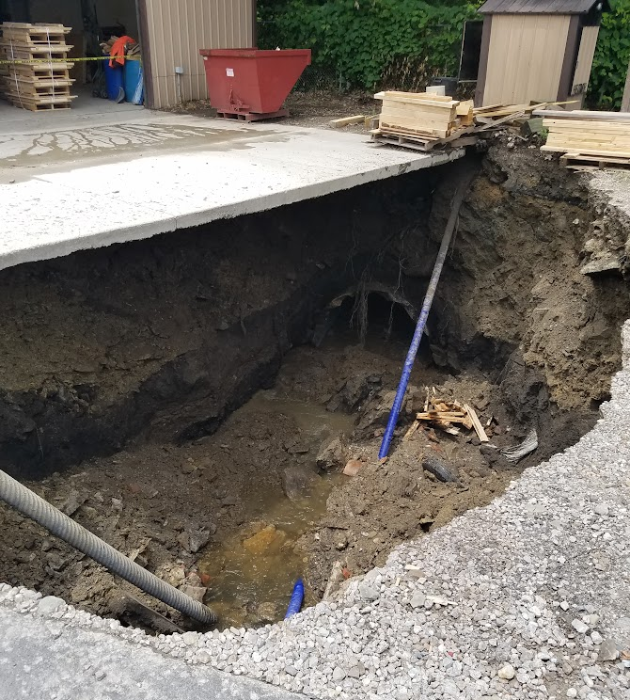
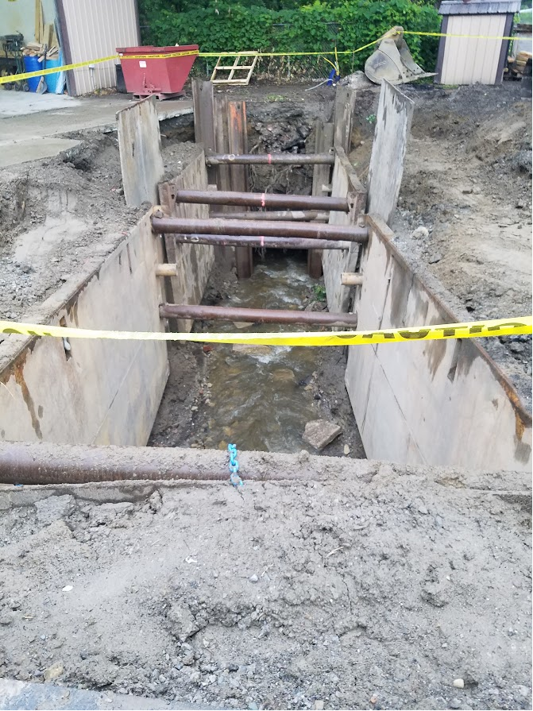
Garrison Run/Frontier Lumber $4.5 million

Slide 26
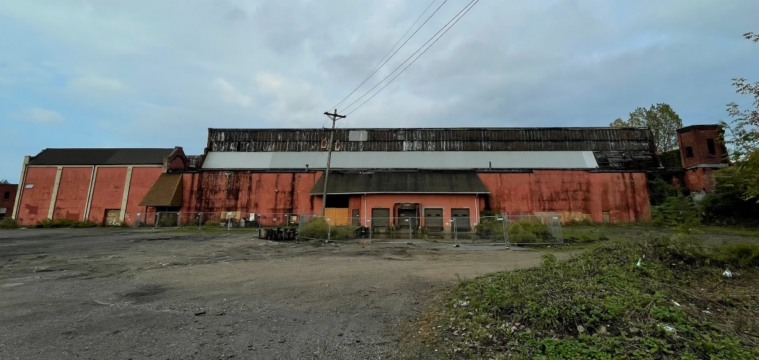
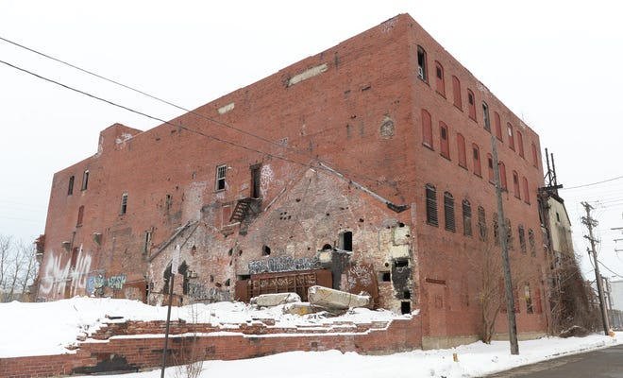
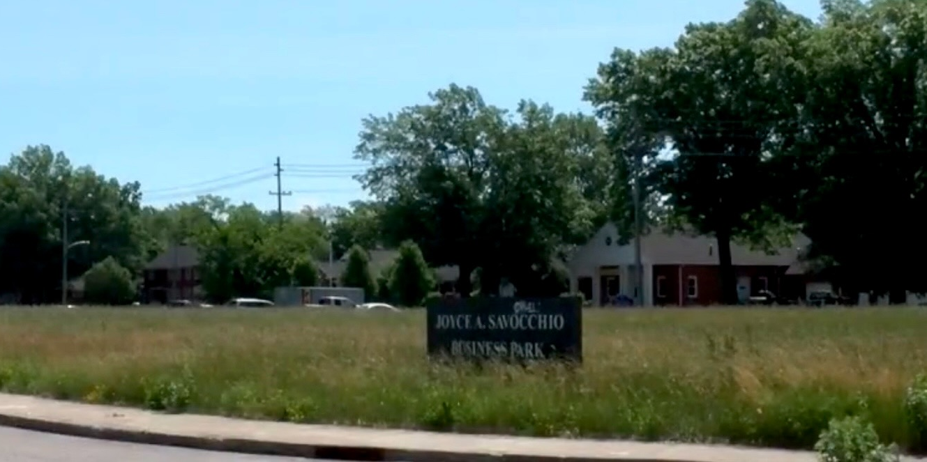
Quin-T/EMI/Savocchio Opportunity Park
$3.1 Million

Slide 27
November 3: RACE/ERA – 8 Programs to Address Housing needs. $15 M towards homeownership, home repair grants and loans November 17: DECD – grants, loans, and technical assistance for small businesses and entrepreneurs; industrial blight remediation, urban core redevelopment December 1: Police proposal related to homelessness, mental health, drug and alcohol, domestic violence, gun violence, juvenile crime December 15: Planning – Parks/Participatory Budgeting, East Bayfront Greenway, Groundwork Trust
Proposed Council Schedule

Slide 28
Social Engagement

Slide 29
Next Steps
Meeting Schedule for CoA
Survey sent before our next meeting regarding DEI framework, measures, and analysis
Communication strategy?

